Slide 1
Using the Decision Tree Algorithm: Pima Indians Diabetes Database
Grace, Regina, Scott, Hang
Notes:
Regina

Slide 2
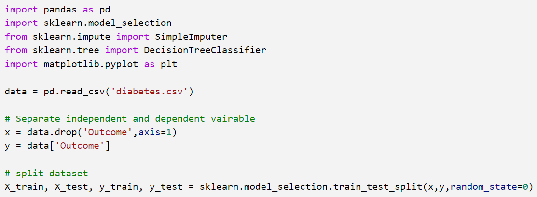
Import Data
Importing modules
Reading in CSV file
Creating x and y (independent and dependent variables)
Splitting dataset into training and test datasets
Notes:
Regina

Slide 3
Data Processing
"this module does not support missing values"
"does not support categorical variables for now"
Group 1's Research | Implementation
General
Feature selection and splitting needed | Feature selection and splitting performed
Typically deals with missing values automatically | No "missing values" in dataset – imputed 0 values, replaced with mean
Can process both numerical and categorical data | Only using numerical data
Not as affected by outliers | Outliers not addressed
Doesn’t require feature scaling | Did not perform feature scaling
Scikit-Learn's Implementation
"this module does not support missing values" | No missing values in dataset
"does not support categorical variables for now" | Categorical variables not present in dataset
"Group 1's Research" column sourced from presentation: "Decision Tree Presentation" (Ben Grudt, Colin Beveridge, Pemba Sherpa, Amy Yucus) - slides 6 & 7
Notes:
Grace

Slide 4
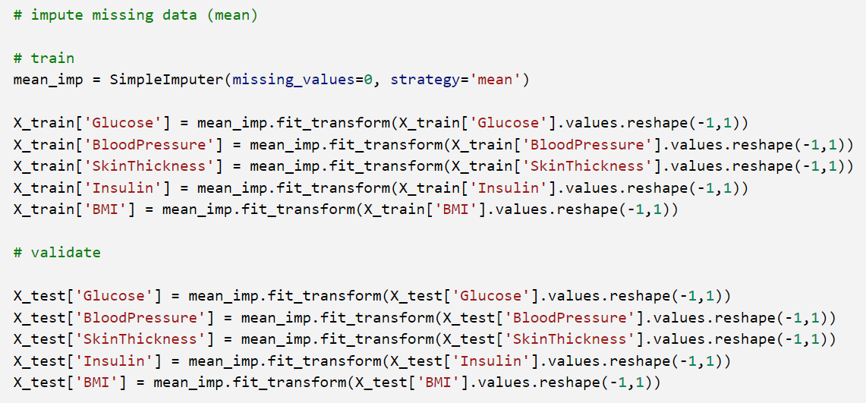
Data Processing
Notes:
Grace

Slide 5
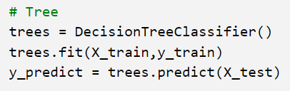
Creating the Model and Predicting
Creating the model
Training the model
Predicting the outcome
Notes:
Scott

Slide 6
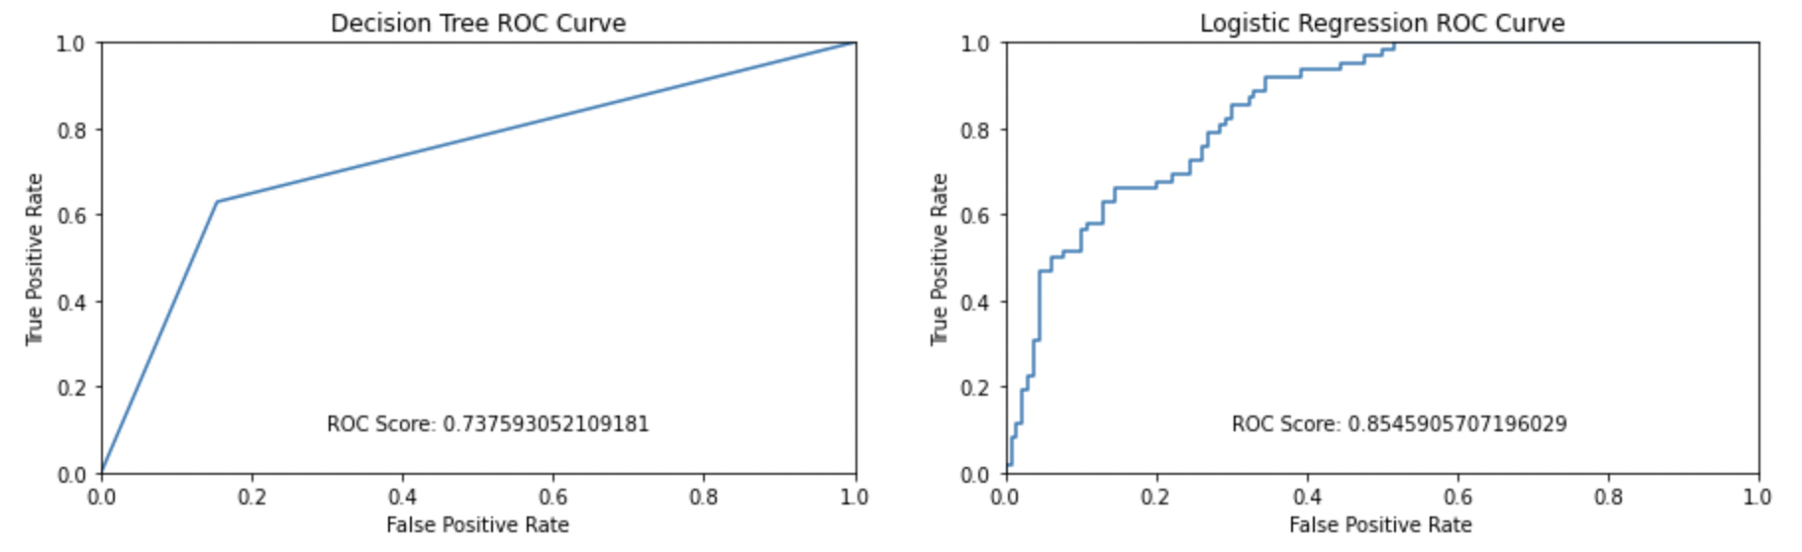
Visualizations: ROC
Notes:
Scott

Slide 7
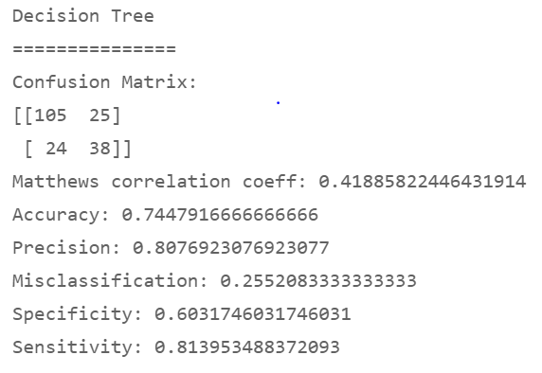
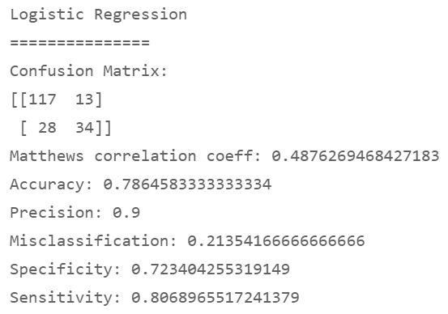
Assessing Performance: Decision Tree vs. Logistic Regression
Decision Tree | Logistic Regression
Notes:
Hang

Slide 8
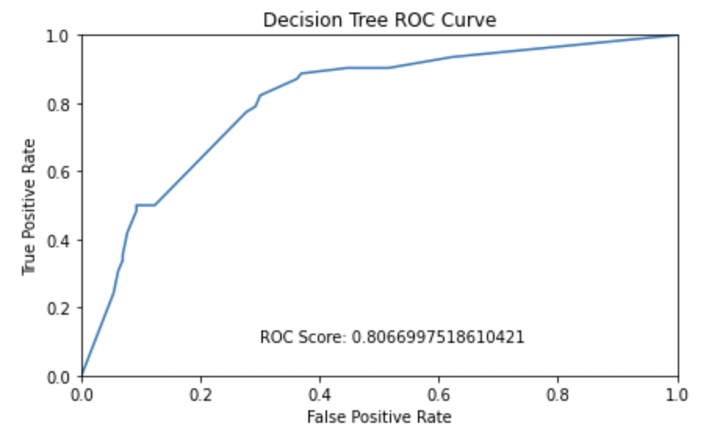
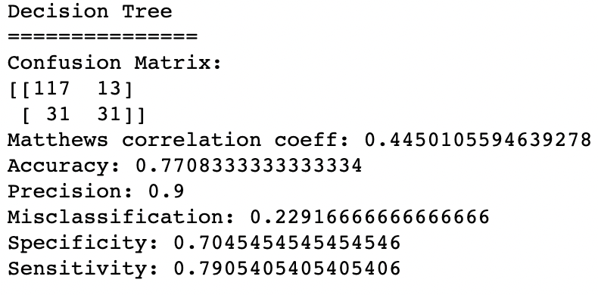
How to increase performance of the model
We could improve the performance of the decision tree model by:
Pruning
Tuning variables such as max_depth, min_samples_split, min_samples_leaf
Notes:
Hang

Slide 9
Conclusion
The data importing and processing steps were the same between use for Decision Tree and logistic regression algorithms.
Steps to create, train, and predict the model were simple.
Logistic regression performed better than decision tree.
ROC Score: 0.85 vs. 0.74
This was probably due to overfitting by decision tree due to the high number of dimensions (variables)
Pruning increases the performance of the decision tree algorithm, but still lower than that of the logistic regression.
Notes:
Regina

